Slide 1
WP4 – AI-based DSS models and advanced analytics
T4.3 – AI models for personalised treatment planning
Vassilis Tsakanikas
University of Ioannina

Slide 2
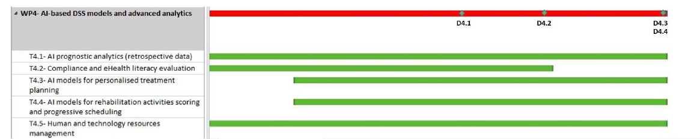
Task 4.3: AI models for personalised treatment planning
Task Description
Leader UOI, Participating partners: BRD, BIOIRC, ICCS, UCL, NKUA), [M7-M32].
This task will cover the development of AI-based models of the TeleRehaB DSS platform that will support experts in selecting the most appropriate intervention plan (considering available resources and cost-effectiveness), set an optimal set of personalised rehabilitation activities, inform them on estimated treatment effectiveness and patient response, along with potential occurrence of side effects and adverse events from Task 4.1.
D4.1 TeleRehaB DSS AI models and advanced analytics v1.
This deliverable will provide the first version of the AI models in time for the start of the clinical study. [M18].

Slide 3
Task 4.3: AI models for personalised treatment planning
INTRODUCTION
TeleRehaB DSS Project Overview
The aim of the TeleRehaB DSS project is to develop an AI-based decision support system to improve and personalize treatment for patients at risk of falls, both in clinic and at home.
Role of AI in TeleRehaB DSS
Artificial Intelligence plays a key role in enhancing treatment precision, personalizing rehabilitation interventions, and providing valuable public health data.
Task 4.3 in Context
Task 4.3 is focused on the development of AI-based models for personalized treatment planning in the TeleRehaB DSS platform.

Slide 4
Task 4.3: AI models for personalised treatment planning
Relative Objectives
III. To unify the existing research and clinical databases, identify gaps in data needed to address the needs of special populations, develop synthetic (reference) data to overcome this barrier and define the structure needed for AI/ML models.
IV. Develop innovative and appropriate AI models from the complex multifactorial falls/balance disorders data and related socioeconomic costs that will automatically link to patient-specific, cost-effective interventions.
V. Develop AI-based predictive analytics for treatment outcomes, side effects and adverse events at baseline and throughout the entire duration of the intervention.

Slide 5
Task 4.3: AI models for personalised treatment planning
Overview
What is Task 4.3?
Task 4.3 involves developing AI-based models that will assist healthcare professionals in creating personalized treatment plans using the TeleRehaB DSS platform.
Purpose of Task 4.3
The goal of these models is to facilitate optimal treatment decisions, design an ideal set of personalized rehabilitation activities, provide estimates on treatment effectiveness, patient responses, and potential side effects or adverse events.
Connection to Overall Project
This task is a critical component of our broader goal of improving and personalizing treatment for patients at risk of falls. Through AI, we aim to enhance clinical decisions, increase patient compliance, and optimize resource allocation

Slide 6
Task 4.3: AI models for personalised treatment planning
AI BASED Models
What are AI-Based Models?
AI-based models are algorithms developed using machine learning techniques that can learn from data, identify patterns, and make predictions or decisions without being explicitly programmed to perform the task.
AI Models in Task 4.3
In the context of Task 4.3, we're developing AI models to help healthcare professionals make the best decisions for personalized treatment plans. These models are designed to handle complex multifactorial data and provide insights into the most effective interventions.
Data Utilized
We're utilizing data from various sources, including medical histories, diagnosis records, physical activity levels, medication data, and more. This ensures our AI models have a comprehensive understanding of the patient's condition.
Decision-Making Support
Our AI models will provide healthcare professionals with predictions and insights, such as the potential effectiveness of a treatment plan, the patient's likely response, and the possible occurrence of side effects. This will support professionals in selecting the most suitable treatment interventions.

Slide 7

Task 4.3: AI models for personalised treatment planning
Intervention Selection
The Challenge
One of the key challenges in healthcare, particularly in rehabilitation, is determining the most suitable intervention plan. It requires careful consideration of the patient's specific circumstances, medical history, and potential benefits and risks.
Role of AI Models in Intervention Selection
AI models aid in this selection process by analyzing complex patient data and recommending interventions that are most likely to be beneficial. This is based on historical data, clinical evidence, and patient-specific factors.
Consideration of Resources and Cost-Effectiveness
The AI models also consider the resources available, including staff time, equipment, and budget, as well as the cost-effectiveness of each potential intervention. This ensures that we're not only selecting the most beneficial treatment but also the most feasible and cost-effective one.
Resulting Benefits
With AI's help, we aim to optimize treatment outcomes, improve patient satisfaction, and ensure efficient resource utilization. This is a major step towards our project's goal of providing effective and affordable treatment for patients at risk of fall.

Slide 8
Task 4.3: AI models for personalised treatment planning
Personalised Rehabilitation Activities
The Importance of Personalisation
Every patient is unique, with distinct needs and abilities. Therefore, a 'one size fits all' approach is not always effective in rehabilitation. Personalisation enhances the effectiveness of treatment and increases patient engagement.
AI's Role in Personalisation
AI models help in personalising rehabilitation activities by analysing a wide range of patient data, from their medical history and current health status to their lifestyle and personal preferences.
Examples of Personalised Rehabilitation Activities
For instance, for a patient with a high risk of falls due to poor balance, the AI model might suggest balance exercises as a primary component of their rehabilitation. The intensity, duration, and progression of these exercises can be tailored to the patient's current abilities and improvement rate.
Benefits of AI-Personalised Rehabilitation Activities
By using AI to personalise rehabilitation activities, we aim to maximise patient engagement, improve treatment outcomes, and increase the efficiency of the rehabilitation process.

Slide 9
Task 4.3: AI models for personalised treatment planning
Estimated Treatment Effectiveness and Patient Response
The Need for Predictions
Being able to predict the likely effectiveness of a treatment and how a patient will respond can help healthcare professionals make informed decisions and manage patient expectations.
How AI Models Can Help
AI models are designed to analyze multifactorial data and provide predictions about treatment effectiveness and patient responses. They consider a multitude of factors including the type of intervention, patient's medical history, and their overall health status.
Examples
For example, the AI models might predict that a specific balance exercise regimen would likely result in a 30% improvement in a patient's balance score over three months. It could also estimate potential challenges the patient might face in adhering to the regimen.
Benefits
These estimates allow healthcare professionals to better tailor their approach, guide patient expectations, and make adjustments as needed throughout the treatment period.

Slide 10
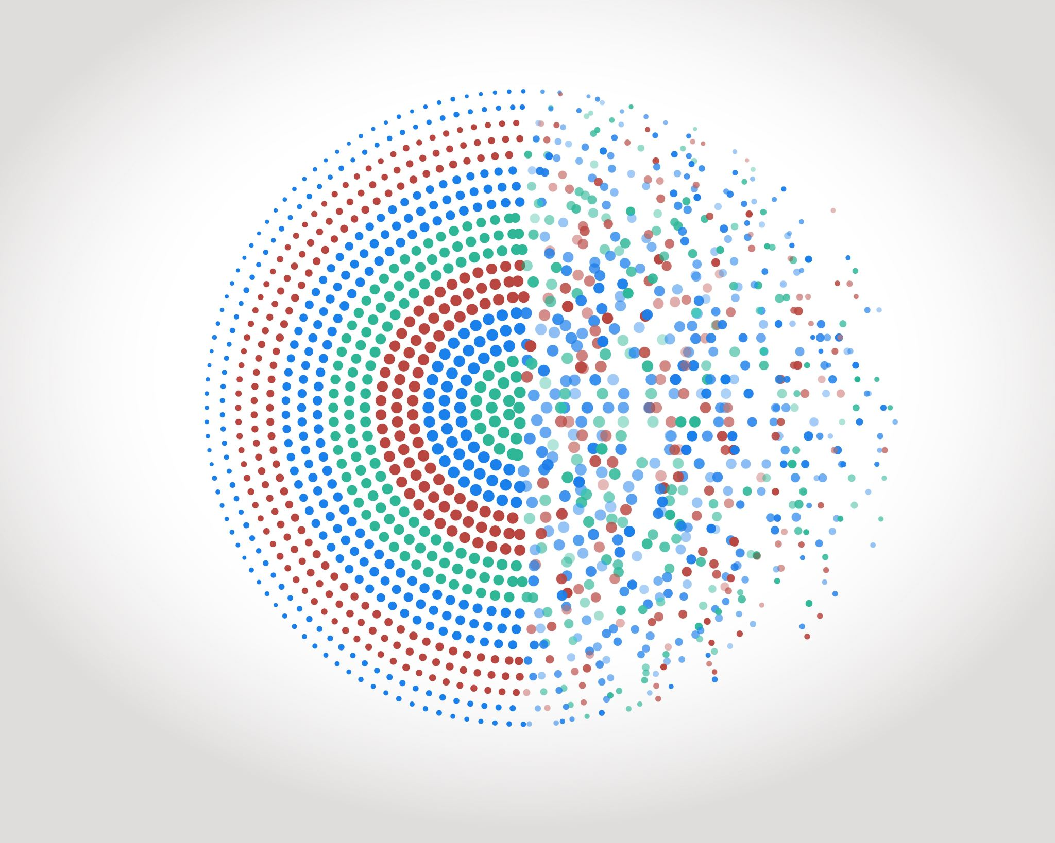
Task 4.3: AI models for personalised treatment planning
Side Effects and Adverse Events Prediction
The Importance of Predicting Side Effects and Adverse Events
Predicting potential side effects and adverse events is crucial to patient safety, compliance, and treatment planning. It allows healthcare professionals to proactively manage risks and inform patients about what to expect.
AI's Role in Predicting Side Effects and Adverse Events
AI models analyze patient data, intervention details, and historical data to predict potential side effects or adverse events. This could range from minor issues like fatigue or discomfort during exercises, to more serious events such as an increased risk of falls.
Examples
For instance, the AI model might predict that a certain exercise could increase fatigue in a patient with specific health conditions. This would allow the healthcare professional to adjust the treatment plan accordingly, such as by scheduling rest periods or modifying the intensity of the exercises.
Benefits
Predicting side effects and adverse events not only enhances patient safety but also aids in improving treatment compliance and effectiveness. By foreseeing and mitigating risks, we can provide a safer, more tailored treatment plan.

Slide 11

Task 4.3: AI models for personalised treatment planning
Integration with Task 4.1
Understanding Task 4.1
Task 4.1 focuses on deploying prognostic analytics of TeleRehaB DSS, analyzing risk of falls, treatment effectiveness, patient response, and potential side effects. It also involves developing a data harmonization engine to manage medical data from multiple sources.
How Task 4.3 Aligns with Task 4.1
Task 4.3 extends the work done in Task 4.1 by using the harmonized data and AI models developed to predict treatment effectiveness, patient responses, and potential adverse events. We're developing additional AI models that further assist healthcare professionals in personalising treatment plans and rehabilitation activities.
Shared Resources and Data
Both tasks rely on the extensive retrospective datasets made available by the consortium and open databases. Task 4.3 benefits from the data harmonization and synthetic data generation done in Task 4.1.
Combined Outcomes
The integration of Tasks 4.1 and 4.3 will provide comprehensive prognostic analytics and decision support to healthcare professionals. This will result in optimised and safer treatment plans, enhanced patient outcomes, and more efficient use of resources.

Slide 12

Task 4.3: AI models for personalised treatment planning
EndPoints
General well-being deterioration and risk of falls
Response to treatment
Treatment side effects
Compliance and adherence to use of novel technologies
Questions to be tackled:
At which time point these AI models will be inferred? (baseline?)
What is the input data matrix for a Telerehab patient?
Which datasets are relevant with the proposed endpoints?
How Task 4.2 is integrated?
How Task 4.5 is integrated?

Slide 13
Task 4.3: AI models for personalised treatment planning
Clinical Input
We need to identify in detail the required endpoints
For each endpoint, which data are relevant?

Slide 14
Task 4.3: AI models for personalised treatment planning
Source of data | General well-being deterioration and risk of falls | Response to treatment | Treatment side effects | Compliance and adherence to use of novel technologies
HOLOBALANCE (Previous Project) | X | X | X | X
NKUA (Greece) |  | X
UKLFR (Germany) |  | X
KCMH (Thailand)
UCL (UK) |  | X
UK Biobank (UCL) | X | X

Slide 15
Task 4.3: AI models for personalised treatment planning
Current Status and Future Plans
Current Status
We have started integrating these models with the data harmonization engine and the prognostic analytics developed under Task 4.1.
Challenges & Solutions
We encountered challenges in integrating multifactorial patient data for model training. However, we've refined our algorithms and made substantial progress.
Future Plans
Our immediate plan is to finalize the development of our AI models and fully integrate them with the prognostic analytics. We will then move on to thorough testing and validation.
Long-term Outlook
In the long-term, we aim to validate the effectiveness of our AI models in improving treatment outcomes, patient compliance, and cost-effectiveness. The ultimate goal is to establish the TeleRehaB DSS as a reliable, effective, and accessible tool for both in-clinic and home-based care for patients at risk of falls.

Slide 16
Utilizing Machine Learning Probabilities for Personalized Rehabilitation Planning
Overview of the Decision Flow Approach:
Use machine learning models to predict patient-specific outcomes across three key endpoints: Risk of Falls, Treatment Effectiveness, and Side Effects/Adverse Events."
Based on these predictions, we guide the selection of the most suitable rehabilitation program and follow-up frequency.
Machine Learning Endpoints:
"Risk of Falls: Assesses the likelihood of falls using measures like balance and mobility."
"Treatment Effectiveness: Evaluates the overall success of the rehabilitation program."
"Side Effects/Adverse Events: Monitors potential negative outcomes like pain and anxiety."
Rehabilitation Program Options:
"Otago: Traditional exercise-based program with periodic follow-ups."
"Full-TELEREHAB: Advanced system with virtual coaching and comprehensive monitoring."
"Light-TELEREHAB: Simplified version of TELEREHAB for patients with lower digital skills."
Sankey Diagram Explanation:
"The diagram visualizes the flow from ML model outputs to rehabilitation program selection and follow-up frequency."
"Each patient's unique ML probabilities influence the path through the diagram, highlighting personalized treatment plans."
Case Example:
"A patient with high 'Risk of Falls' probability might be directed more towards 'Full-TELEREHAB' with 'Frequent Follow-Up' based on the combined ML model inferences."
"This visual representation aids clinicians in understanding and explaining the decision-making process to patients."

Slide 17
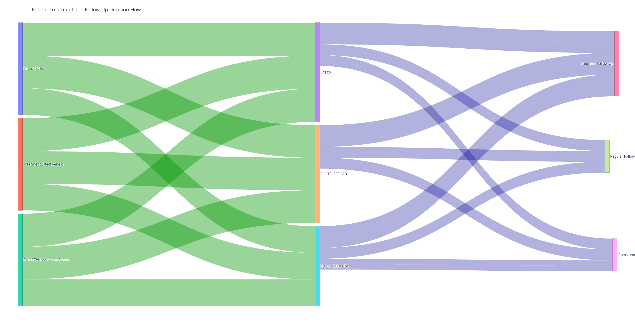
Shankey Diagram

Slide 18
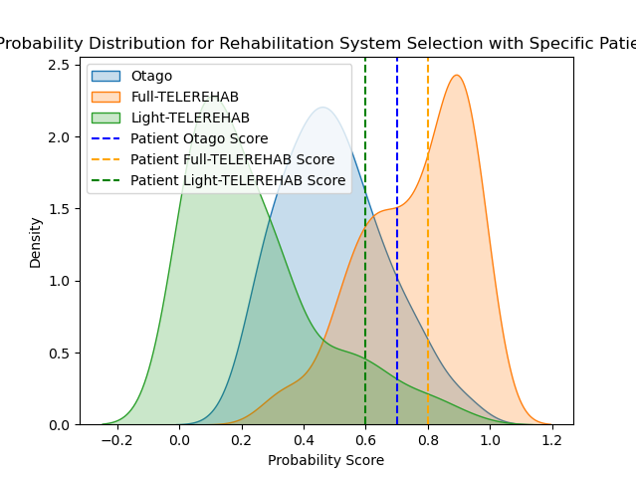

Slide 19
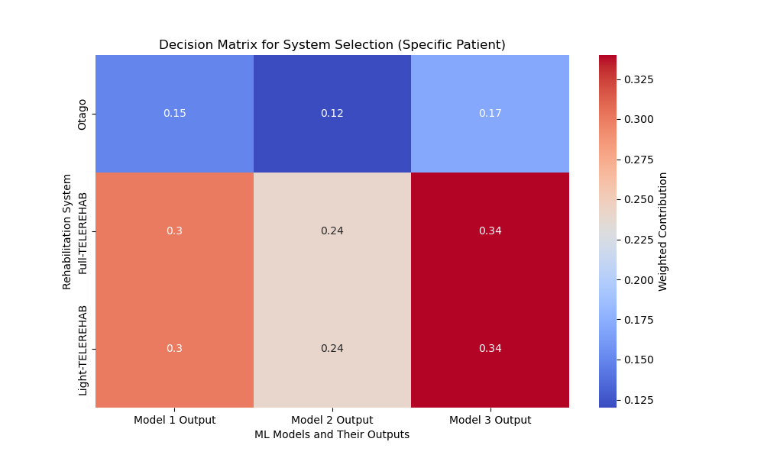

Slide 20
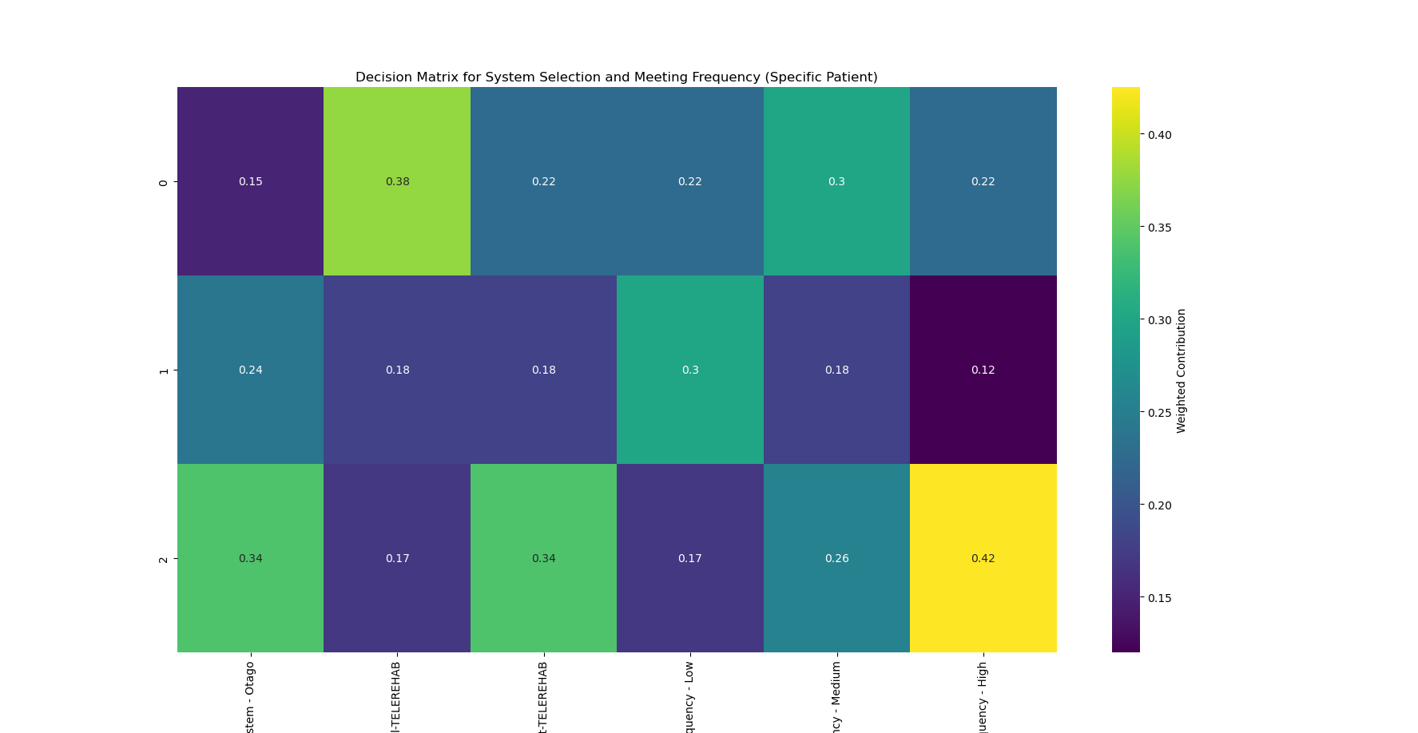

Slide 21
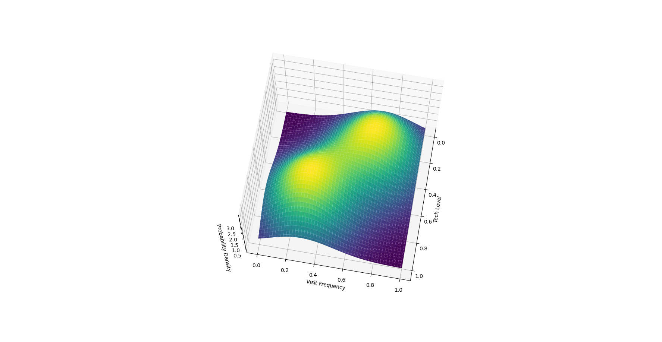

Slide 22
Task 4.3: AI models for personalised treatment planning
Conclusions
Summary of Task 4.3
Task 4.3 involves developing AI models to help personalize treatment planning, select appropriate rehabilitation activities, and predict treatment effectiveness and potential side effects. These models work hand in hand with the prognostic analytics and data harmonization developed under Task 4.1.
Impact of Task 4.3
The work done in Task 4.3 is essential in making the TeleRehaB DSS a comprehensive tool for optimizing and personalizing treatment for patients at risk of falls. It enhances the precision and effectiveness of interventions, improves patient safety and compliance, and ensures efficient use of resources.
Future Outlook
As we continue to refine and validate our AI models, we anticipate that they will become even more precise and effective. We are excited about the potential of the TeleRehaB DSS to transform treatment for patients at risk of falls."
Final Thoughts
We firmly believe in the transformative potential of AI in healthcare, and we are confident that the TeleRehaB DSS project will contribute significantly to this transformation.

Slide 23
Thanks for your attention.
Any question?

